Slide 1

JQuiz
Programming Master
Name: Nazmul HASSAN
Id: 1734318
Programme: BSc (Hons) Computer Science
Module: Final Project (CN6103)

Slide 2

PROJECT AIM
Developing software for students to improve their knowledge of programming languages.
Student can solve the programming problems and examine themselves.
Student can be download this software from the website and it will be offline software.

Slide 3
PROJECT OBJECTIVS
Investigate
Determine
Find the Bugs
Design
Develop
Evaluate
Test & Debug

Slide 4
SIMILAR PLATFORM
W3 School (Web Based)
Code Academy (Web Based)
URI Online Judge (Web Based)
Code Forces (Web Based)

Slide 5
BACKGROUND PROBLEM
Similar application was developed on the web based platform.
Web based platform are not available if there is No internet connection.
Countries Like Nigeria, Paraguay, Iraq where internet are vary rare and internet speed also Less than 1Mbps.

Slide 6
PROBLEM SOLUTION
This Software will be Offline Version.
Any one can use this software with out internet connection.
Easy to use & user friendly interface.
Created on Windows Device Platform.

Slide 7
LEGAL AND ETHICAL ISSUES
I am not collecting any Information Like
Name
Email / Phone number
Location
Or Any other personal information
Anyone can start using the program just putting his name and password as login information. So his progress will be saved on his account.
There is no Legal or Ethical Issues in my software.

Slide 8
ESSENTIAL ELEMENTS & TOOLS
C# Programming Language
Visual Studio For Coding
SQL Server For Database
Illustrator For Icon & Images

Slide 9
LITERATURE REVIEW
Review of Educational Technology in English Language Teaching in China
-- Zhao-Guo Ding (Sch. of Foreign Studies, Shandong Economic Univ., Jinan)
-- Conference Location: Wuhan, Hubei, China (2009)
Accelerating educational technologies using software product lines
-- S. Chimalakonda and K. V. Nori (IIIT-Hyderabad, India)
-- Conference Location: Kerala, India (2012)
Education via advanced technologies
-- P. Penfield and R.C. Larson (Dept. of Electr. Eng. & Comput. Sci., MIT, Cambridge, MA, USA)
-- ISSN Information: Print ISSN: 0018-9359 Electronic ISSN: 1557-9638 (1996)

Slide 10
DEVELOPING PROGRESS
Completed 70% of literature research.
Completed User interface design.
Started coding & still researching on code Debugging.
Working on SQL Server.

Slide 11
PROJECT PLANNING
Project Plan
Project IDEA
Project Name
Proposal
Project Analysis
Literature Review
Presentation
Research C#
Research Code Debugging
Research on SQL Server
Design ERD/ DFD/ USE Case
Implementation
Testing & Validating
Report
User Manual
Feedback

Slide 12
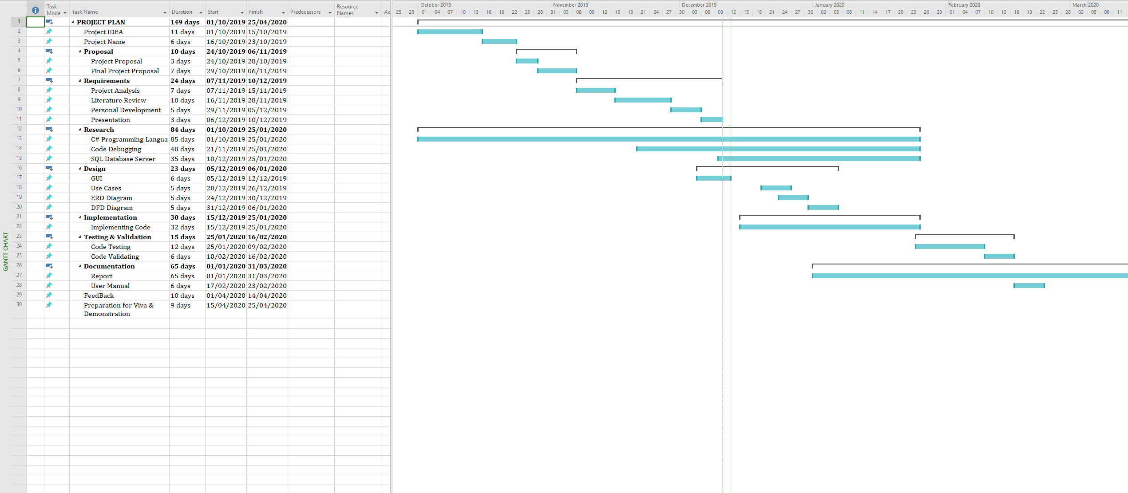
GANTT CHART

Slide 13
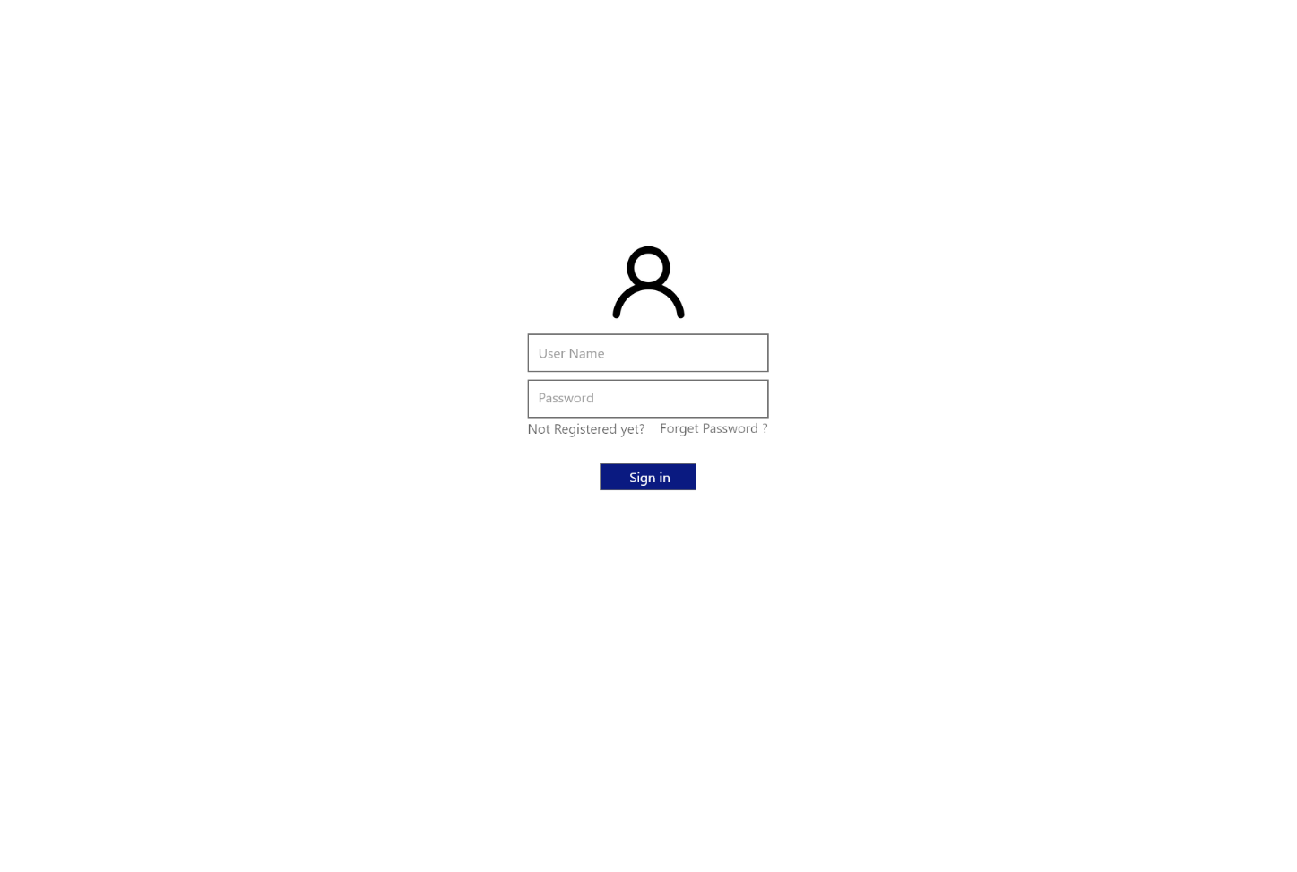
DEMO GUI / LOGIN

Slide 14
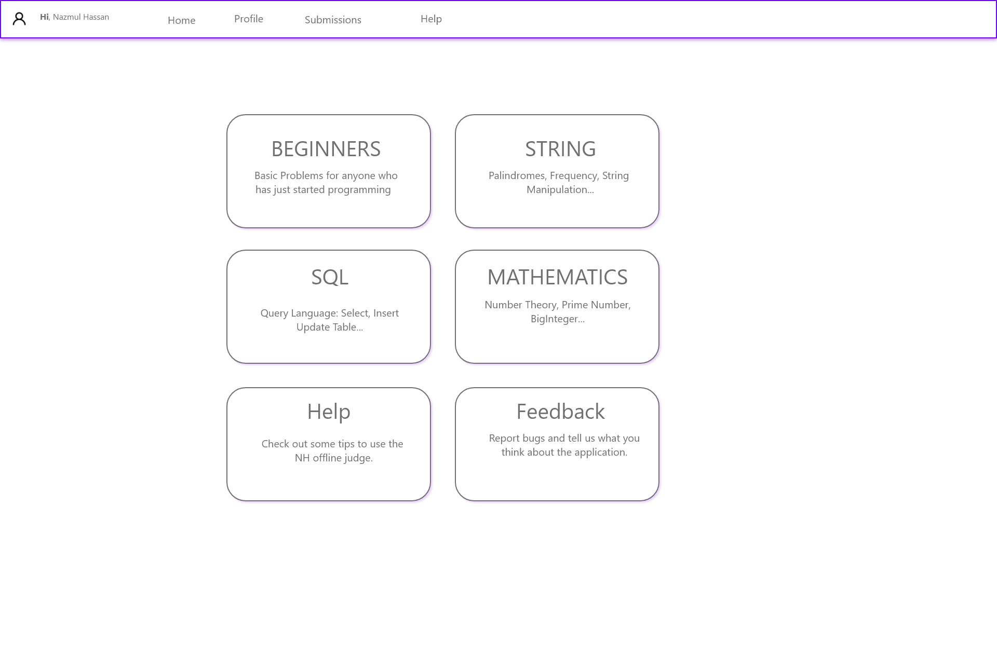
DEMO GUI / MAIN PAGE

Slide 15
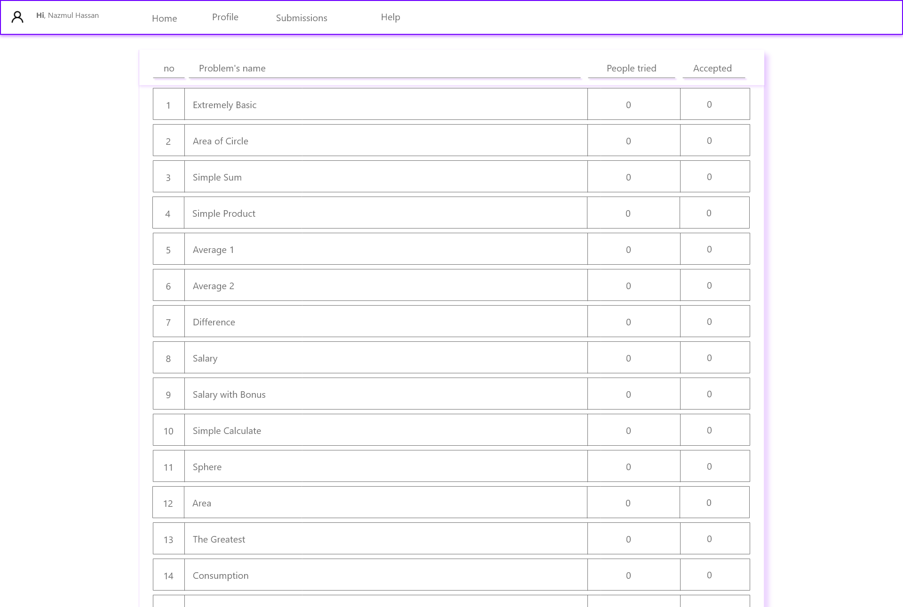
DEMO GUI / QUESTION BANK

Slide 16
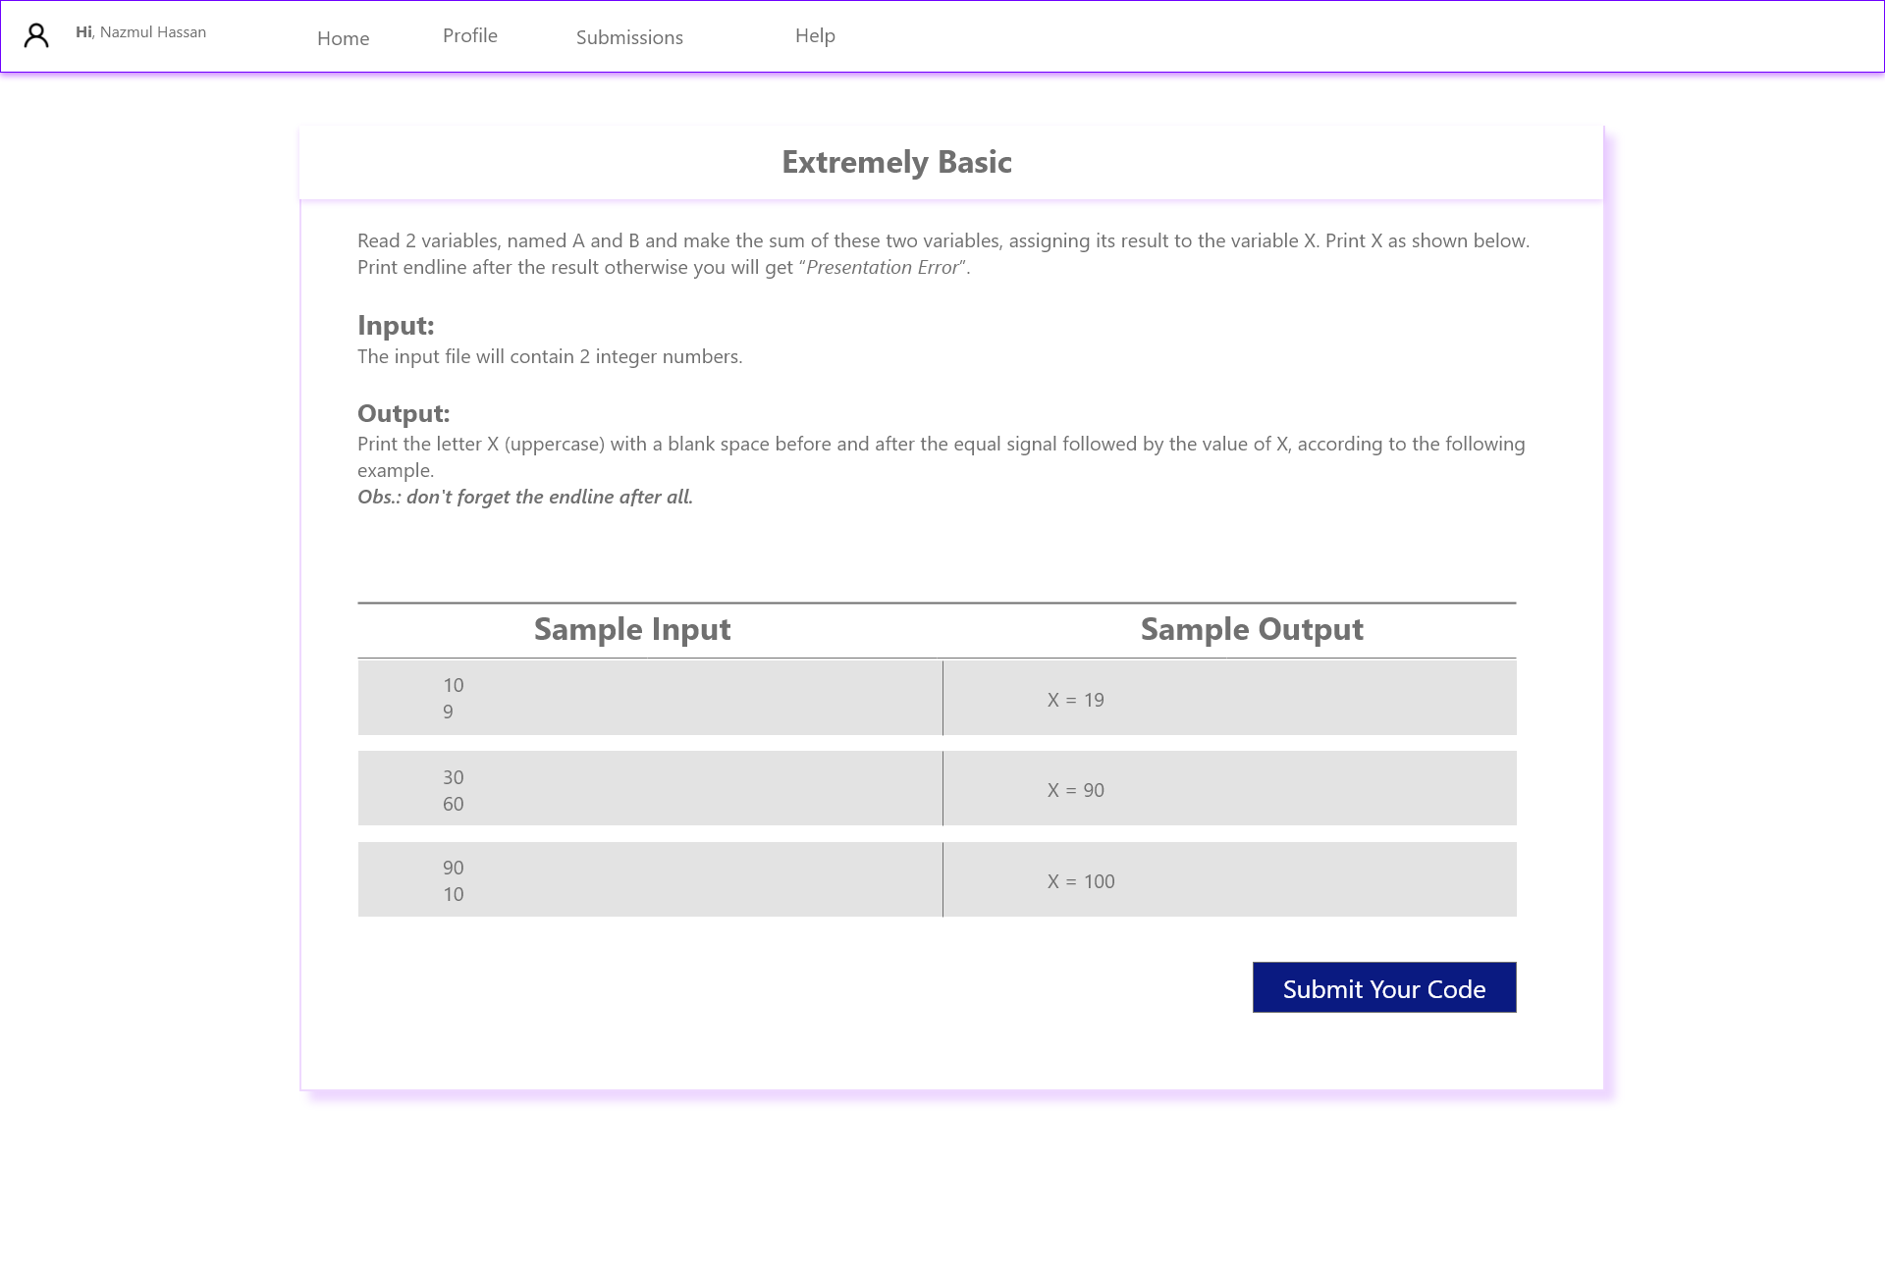
DEMO GUI / QUESTION

Slide 17
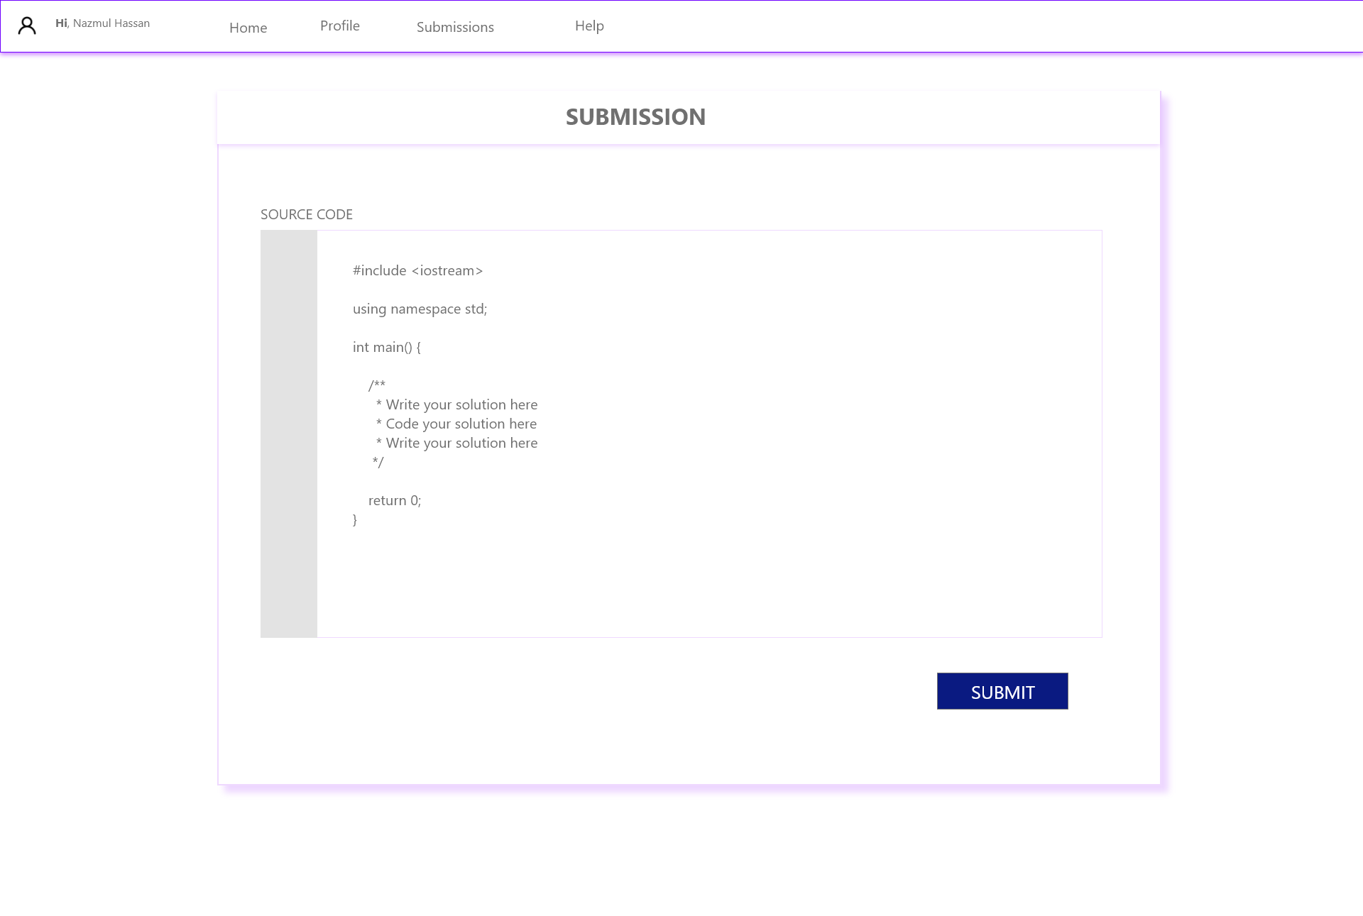
DEMO GUI / QUESTION

Slide 18
REFERENCE
S. Chimalakonda and K. V. Nori, "Accelerating educational technologies using software product lines," 2012 IEEE International Conference on Technology Enhanced Education (ICTEE), Kerala, 2012, pp. 1-4. doi: 10.1109/ICTEE.2012.6208608 URL:http://ieeexplore.ieee.org/stamp/stamp.jsp?tp=&arnumber=6208608&isnumber=6208589
P. Penfield and R. C. Larson, "Education via advanced technologies," in IEEE Transactions on Education, vol. 39, no. 3, pp. 436-443, Aug. 1996. doi: 10.1109/13.538770 URL: http://ieeexplore.ieee.org/stamp/stamp.jsp?tp=&arnumber=538770&isnumber=11591
Z. Ding, "A Critical Review of Educational Technology in English Language Teaching in China," 2009 First International Workshop on Education Technology and Computer Science, Wuhan, Hubei, 2009, pp. 391-394. doi: 10.1109/ETCS.2009.349 URL: http://ieeexplore.ieee.org/stamp/stamp.jsp?tp=&arnumber=4959063&isnumber=4958969

Slide 19
THANK YOU

